Slide 1
Decision tree models in R
Howard Thom
London, 8-July-2019
Notes:
3-3.15 Walk to Canynge Hall
3.15 Tea/coffee on arrival
3.25 Welcome from one of the Professors (just confirming which one)
3.35 Ruth Kipping and Debbi Caldwell: introduction and overview of the course and questions
4.00-4.15 Public Health PhD students talking about experience of teaching at the School (Laura Tinner, Heide Busse and Kaiseree Dias)
4.15-4.30 opportunity to use toilet facilities and talk informally to Programme Leads and PhD Students
4.30-4.40 Careers service talk
4.40-5.00 Walk from Canynge Hall to Life Sciences

Slide 2
Two steps
Implementing a (deterministic) decision tree in R
Code in “depression.decision.tree.deterministic.R"
Making the decision tree probabilistic
Code in “depression.decision.tree.probabilistic.R"

Slide 3
A deterministic decision tree in R
Open “depression.decision.tree.deterministic.R"

Slide 4




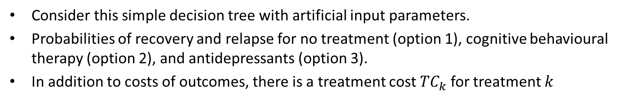
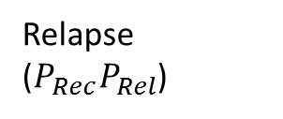

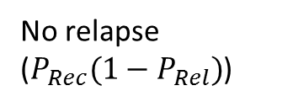



Simple decision tree in R
No relapse ($P_{Rec}(1−P_{Rel})$)
Costs
Effects
Depressed
(No treatment, CBT, or antidepressants)
$$c_{Rec}$$
$$q_{Rec}$$
Recovery ($P_{Rec}$)
$$c_{Rel}$$
$$q_{Rel}$$
Relapse
($P_{Rec}P_{Rel}$)
$$c_{No rec}$$
$$q_{No rec}$$
No recovery ($1−P_{Rec}$)
Consider this simple decision tree with artificial input parameters.
Probabilities of recovery and relapse for no treatment (option 1), cognitive behavioural therapy (option 2), and antidepressants (option 3).
In addition to costs of outcomes, there is a treatment cost ${TC}_{k}$ for treatment $k$

Slide 5

Initial set-up
Number and names of treatments

Slide 6
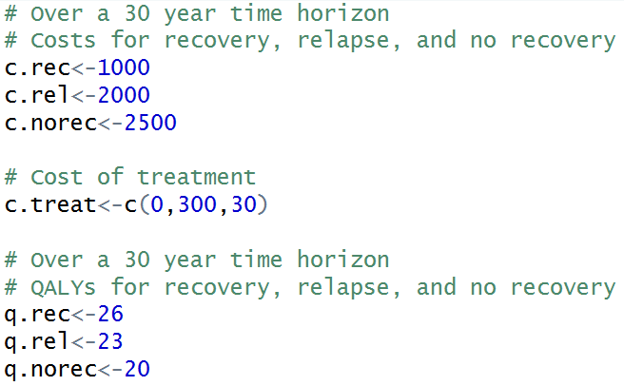
Defining the costs and QALYS of each outcome
Costs and QALYs for recovery, relapse, and no recovery.

Slide 7
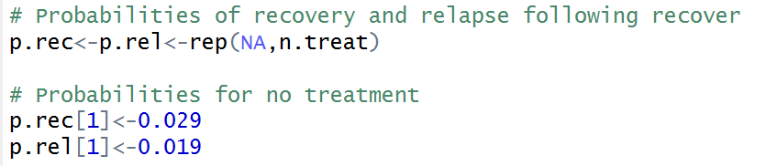
Probabilities of recovery and relapse
These are 3 element vectors with a probability of the outcome for each of 3 treatments
Use the same format for probabilities on CBT and antidepressant

Slide 8
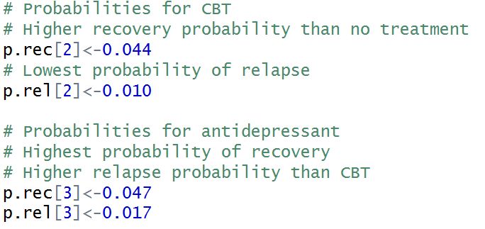

Probabilities for CBT and antidepressants
Names the elements of these vectors after the treatments

Slide 9
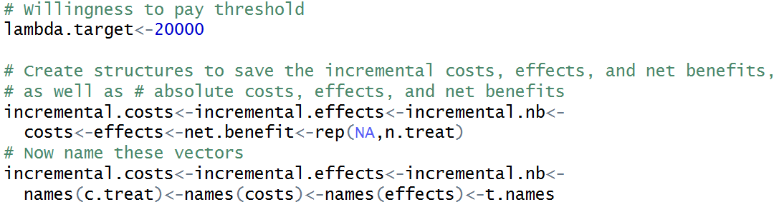
Final set up before generating results
Willingness-to-pay threshold is £20,000
Set up vectors to store results and name them after the treatments

Slide 10



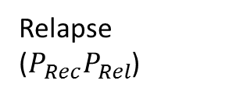

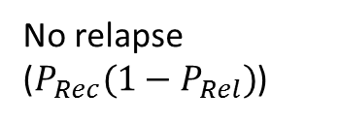





Total costs and effects for treatment k
No relapse ($P_{Rec}(1−P_{Rel})$)
Costs
Effects
Depressed
(No treatment, CBT, or antidepressants)
$$c_{Rec}$$
$$q_{Rec}$$
Recovery ($P_{Rec}$)
$$c_{Rel}$$
$$q_{Rel}$$
Relapse
($P_{Rec}P_{Rel}$)
$$c_{No rec}$$
$$q_{No rec}$$
No recovery ($1−P_{Rec}$)
Treatment costs
Costs if recover,
then relapse
Costs if recover, no relapse
Costs if no recovery
$${Total costs}_{k}={TC}_{k}+P_{Rec,k}×\left(1−P_{Rel,k}\right)×c_{Rec}+P_{Rec,k}×P_{Rel,k}×c_{Rel}+\left(1−P_{Rec,k}\right)×c_{No rec}$$
$${Total effects}_{k}=P_{Rec,k}×\left(1−P_{Rel,k}\right)×q_{Rec}+P_{Rec,k}×P_{Rel,k}×q_{Rel}+\left(1−P_{Rec,k}\right)×q_{No rec}$$
QALYs if recover, no relapse
QALYs if recover, then relapse
QALYs if no recovery

Slide 11
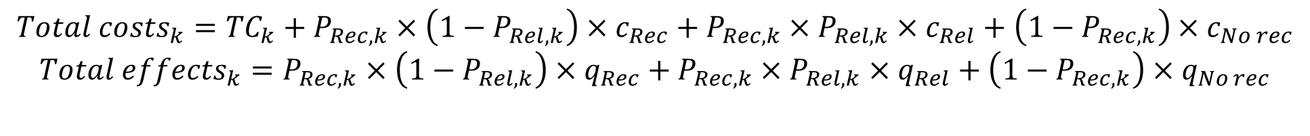
Total costs and effects in R
$${Total costs}_{k}={TC}_{k}+P_{Rec,k}×\left(1−P_{Rel,k}\right)×c_{Rec}+P_{Rec,k}×P_{Rel,k}×c_{Rel}+\left(1−P_{Rec,k}\right)×c_{No rec}$$
$${Total effects}_{k}=P_{Rec,k}×\left(1−P_{Rel,k}\right)×q_{Rec}+P_{Rec,k}×P_{Rel,k}×q_{Rel}+\left(1−P_{Rec,k}\right)×q_{No rec}$$

Slide 12
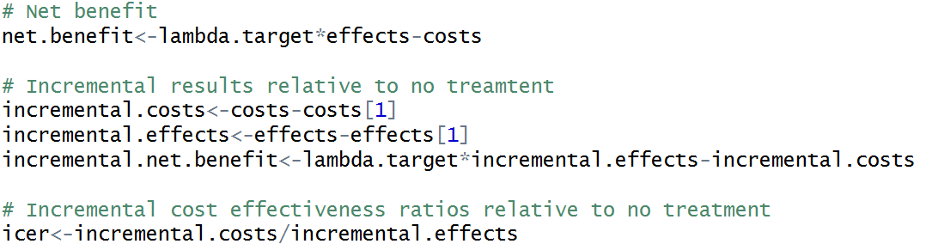
Results of the model
Use above code to generate cost-effectiveness comparative results

Slide 13
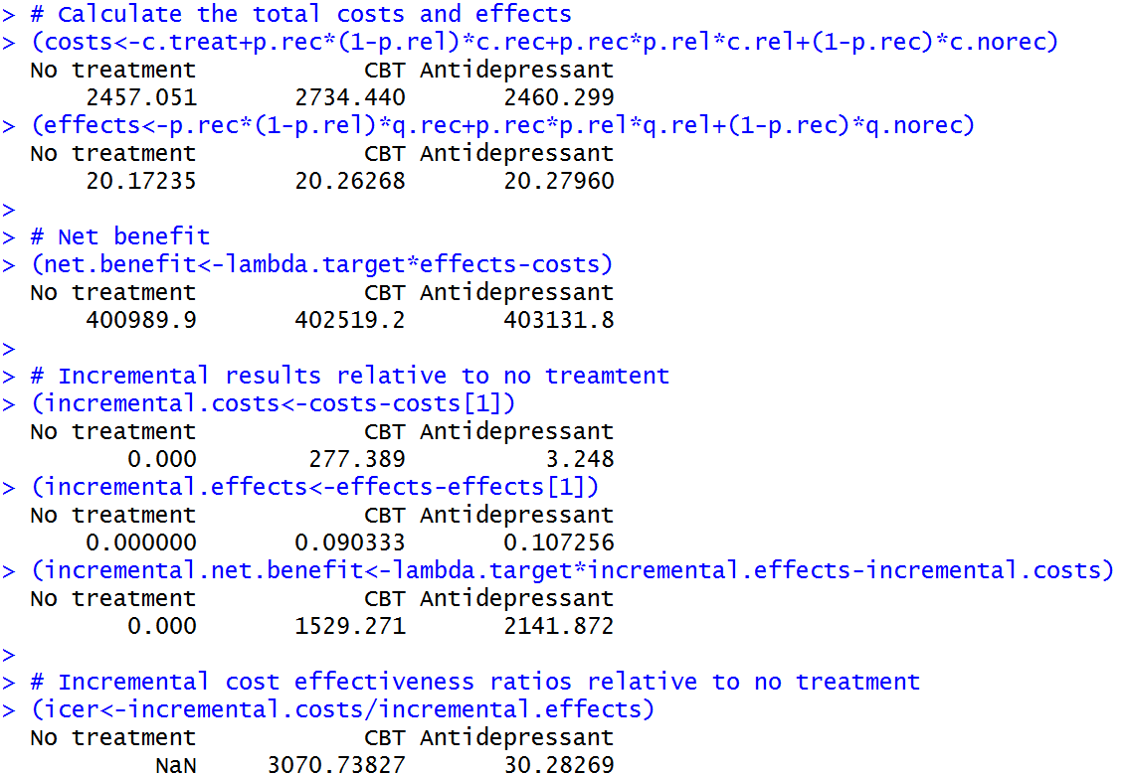
And what do they say?
Costs higher on CBT but about the same on antidepressants
QALYs higher on both CBT and antidepressants
Net benefit highest on antidepressants.
CBT cost-effective at willingness-to-pay £20,000.
But antidepressants have lowest ICER

Slide 14
Making the decision tree probabilistic
Open “depression.decision.tree.probabilistic.R"

Slide 15
Parameter uncertainty
In practice, parameter inputs to our models can be uncertain
They are estimated using small studies or elicited from expert opinion
Probabilities of recovery or relapse based on trial data
Lifetime QALYs based on patient surveys
Lifetime costs estimated based on hospital statistics
Treatment costs (e.g. dose monitoring) based on cohort studies
This leads to uncertainty in the total costs, QALYs, and the estimated ICER

Slide 16
Deterministic sensitivity analysis
Sets parameters to extreme but plausible limits
Highlights parameters to which decision is most sensitive
Probability recovery
Probability relapse
Lifetime QALYs recovery
Lifetime QALYs relapse
Net benefit antidepressants vs no treatment (illustrative only)

Slide 17
Probabilistic sensitivity analysis
An alternative is to put a probability distribution on the parameters
In depression we previously assumed lifetime cost of recovery was £1000
Could use normal distribution Normal(mean=1000,sd=50) to represent uncertainty…

Slide 18

Initial set-up
You’ll notice a new line of code towards the start of the file that sets the number of PSA samples
We can set this to whatever number we want but 1000 is sufficient for stability for this simple model.

Slide 19
Making it probabilistic (core code)
See any difference?
R performs the same calculations whether the p.rec and other variables are vectors or scalars
However, we need to define these parameters as probabilistic.
effects<-p.rec*(1-p.rel)*q.rec+p.rec*p.rel*q.rel+(1-p.rec)*q.norec
costs<-c.treat+p.rec*(1-p.rel)*c.rec+p.rec*p.rel*c.rel+(1-p.rec)*c.norec
net.benefit<-lambda*effects-costs
incremental.nb<-net.benefit-net.benefit[,1]

Slide 20
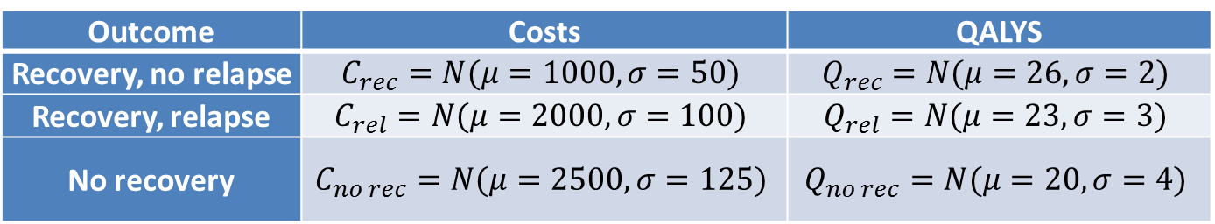
Making it probabilistic (Costs, Utilities)
Outcome | Costs | QALYS
Recovery, no relapse | $$C_{rec}=N(μ=1000,σ=50)$$ | $$Q_{rec}=N(μ=26,σ=2)$$
Recovery, relapse | $$C_{rel}=N(μ=2000,σ=100)$$ | $$Q_{rel}=N(μ=23,σ=3)$$
No recovery | $$C_{no rec}=N(μ=2500,σ=125)$$ | $$Q_{no rec}=N(μ=20,σ=4)$$
# Costs for recovery, relapse, and no recovery
c.rec<-rnorm(n=n.samples, mean=1000, sd=50)
c.rel<-rnorm(n=n.samples, mean=2000, sd=100)
c.norec<-rnorm(n=n.samples, mean=2500, sd=125)
# QALYs for recovery, relapse, and no recovery
q.rec<-rnorm(n=n.samples, mean=26, sd=2)
q.rel<-rnorm(n=n.samples, mean=23, sd=3)
q.norec<-rnorm(n=n.samples, mean=20, sd=4)

Slide 21
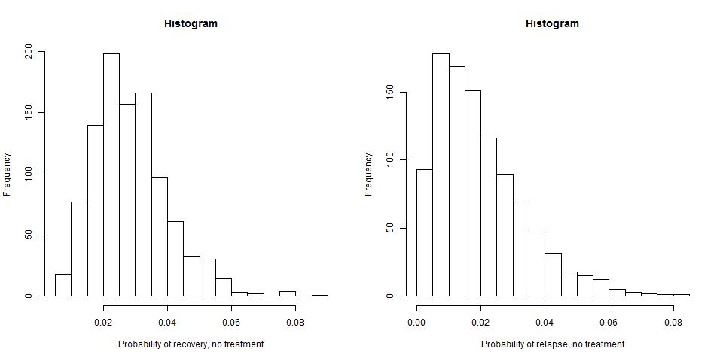
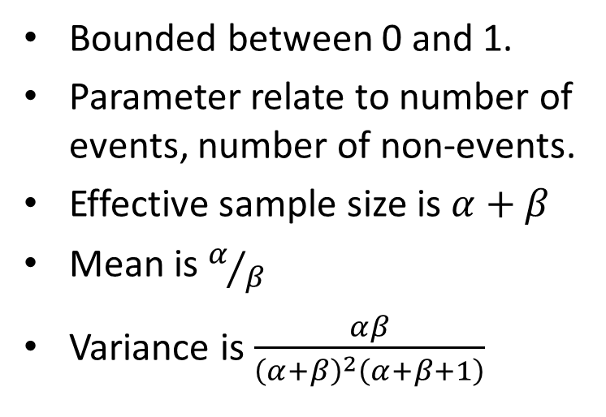
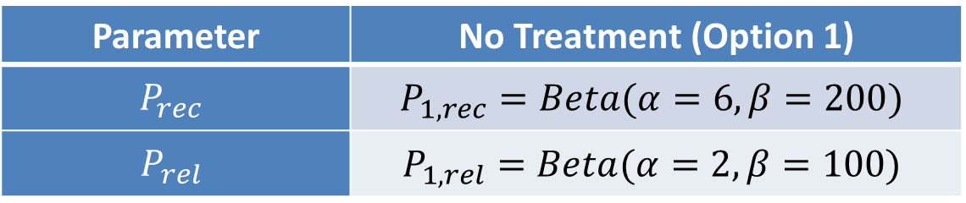
Beta distributions for probability recovery and relapse
Parameter | No Treatment (Option 1)
$$P_{rec}$$ | $$P_{1, rec}=Beta(α=6,β=200)$$
$$P_{rel}$$ | $$P_{1,rel}=Beta(α=2,β=100)$$
Bounded between 0 and 1.
Parameter relate to number of events, number of non-events.
Effective sample size is $α+β$
Mean is $α/β$
Variance is $\frac{αβ}{{\left(α+β\right)}^{2}\left(α+β+1\right)}$

Slide 22
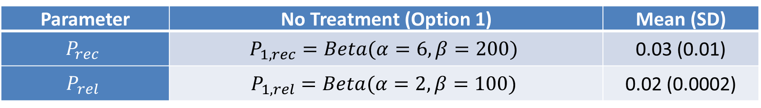
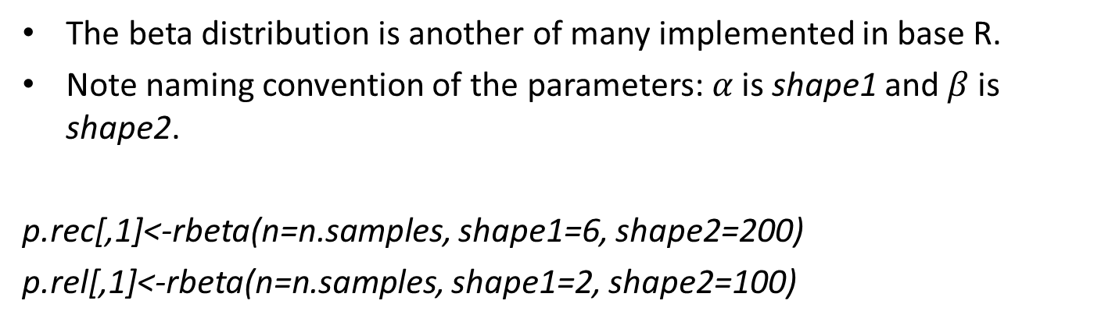
Making it probabilistic (Reference probabilities)
Parameter | No Treatment (Option 1) | Mean (SD)
$$P_{rec}$$ | $$P_{1, rec}=Beta(α=6,β=200)$$ | 0.03 (0.01)
$$P_{rel}$$ | $$P_{1,rel}=Beta(α=2,β=100)$$ | 0.02 (0.0002)
The beta distribution is another of many implemented in base R.
Note naming convention of the parameters:$α$ is shape1 and $β$ is shape2.
p.rec[,1]<-rbeta(n=n.samples, shape1=6, shape2=200)
p.rel[,1]<-rbeta(n=n.samples, shape1=2, shape2=100)
Population Health Sciences

Slide 23
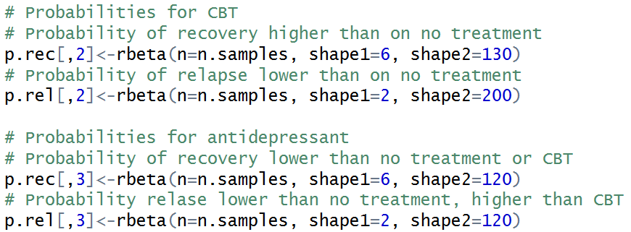
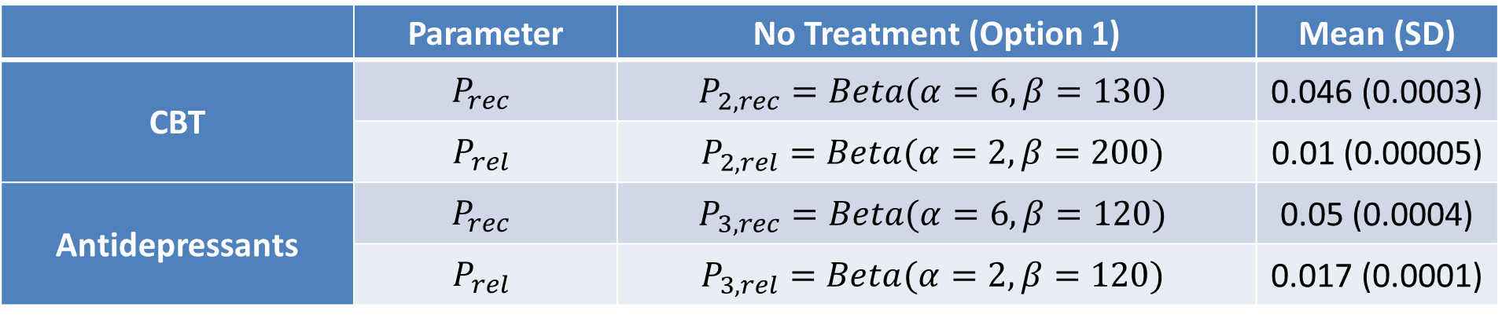
Probabilities for comparators
 | Parameter | No Treatment (Option 1) | Mean (SD)
CBT | $$P_{rec}$$ | $$P_{2, rec}=Beta(α=6,β=130)$$ | 0.046 (0.0003)
 | $$P_{rel}$$ | $$P_{2,rel}=Beta(α=2,β=200)$$ | 0.01 (0.00005)
Antidepressants | $$P_{rec}$$ | $$P_{3, rec}=Beta(α=6,β=120)$$ | 0.05 (0.0004)
 | $$P_{rel}$$ | $$P_{3,rel}=Beta(α=2,β=120)$$ | 0.017 (0.0001)

Slide 24
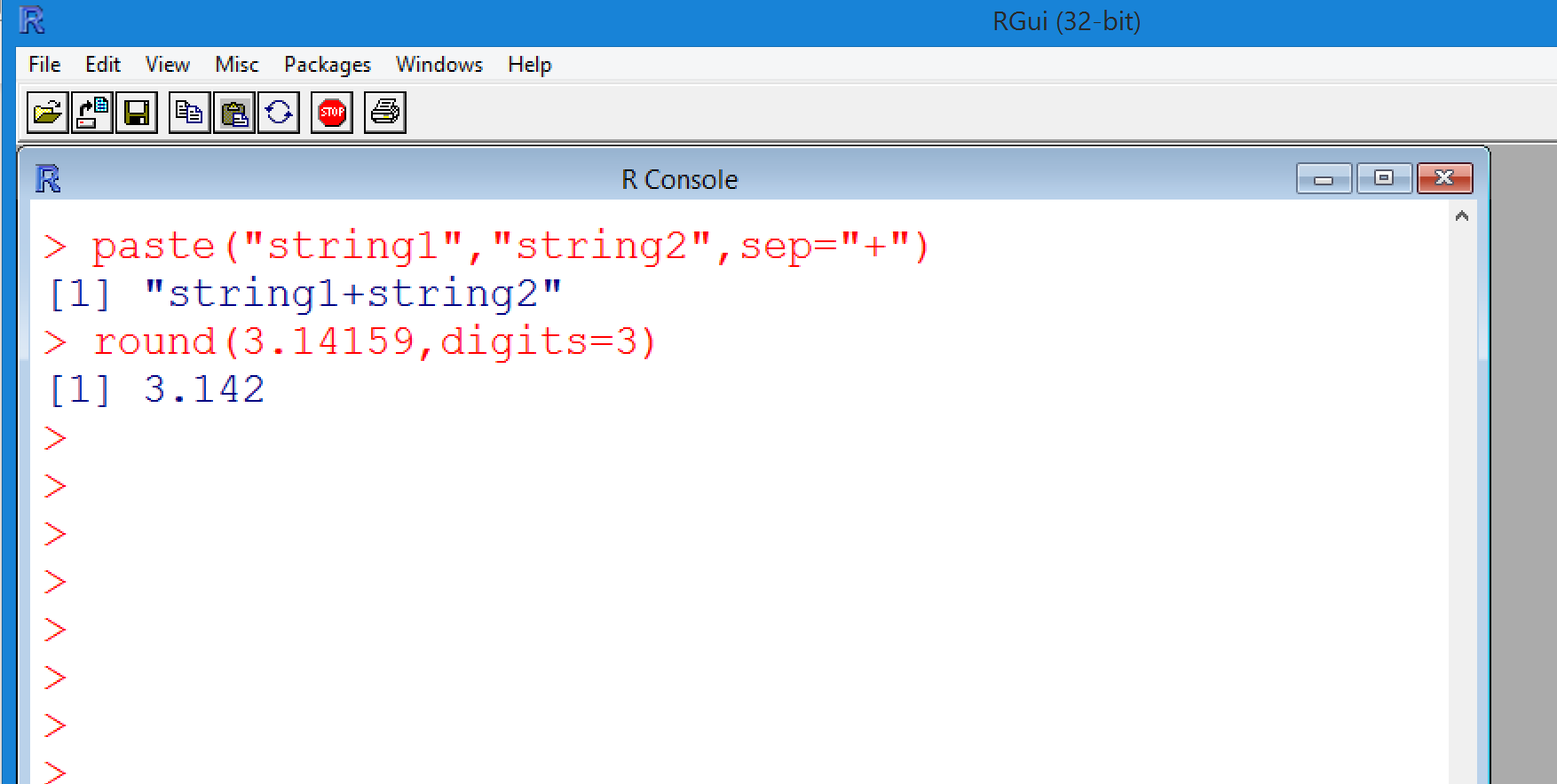

Formatting results
Recall paste(“string1”, “string2”) function for string concatenation
Recall round(x,digits=3) for numeric formatting
format.results<-function(x,digits=2)
{
paste(round(mean(x),digits=digits)," (",round(quantile(x,probs=0.025),digits=digits),", ",round(quantile(x,probs=0.975),digits=digits),")",sep="")
}

Slide 25
Decision tree results
Build a results matrix
results.matrix<-matrix(NA, nrow=4,ncol=n.treat)
Name the rows and columns
rownames(results.matrix)<-c("Total costs","Total QALYs", "Net Benefit","Incremental NB")
colnames(results.matrix)<-t.names
Then calculate summaries
for(i.treat in 1:n.treat)
{
results.matrix["Total costs",i.treat]<-format.results(x=costs[,i.treat])
results.matrix["Total QALYs",i.treat]<-format.results(x=effects[,i.treat])
results.matrix["Net Benefit",i.treat]<-format.results(x=net.benefit[,i.treat])
results.matrix["Incremental NB",i.treat]<-format.results(x=incremental.nb[,i.treat])
}
Population Health Sciences

Slide 26
Exporting the results matrix to Excel
Export as a csv, which is readable in Excel
write.csv(results.matrix, file="depression.results.csv")
 | No treatment | CBT | Antidepressant
Total costs | 2451.07 (2210.36, 2691.42) | 2729.25 (2497, 2975.34) | 2451.69 (2220.78, 2697.22)
Total QALYs | 20.18 (12.88, 27.48) | 20.26 (13.13, 27.49) | 20.29 (13.19, 27.41)
Net Benefit | 0 (0, 0) | 278.18 (218.85, 334.57) | 0.61 (-75.5, 60.12)
Incremental NB | 0 (0, 0) | 0.09 (-0.16, 0.48) | 0.12 (-0.15, 0.62)
Population Health Sciences

Slide 27
Summary
We have implemented a very simple decision model in R
We then made it probabilistic to conduct probabilistic sensitivity analysis
Gianluca will now show how to analyse the results using BCEA...

